Slide 1
Building Blocks Industrialization

Slide 2
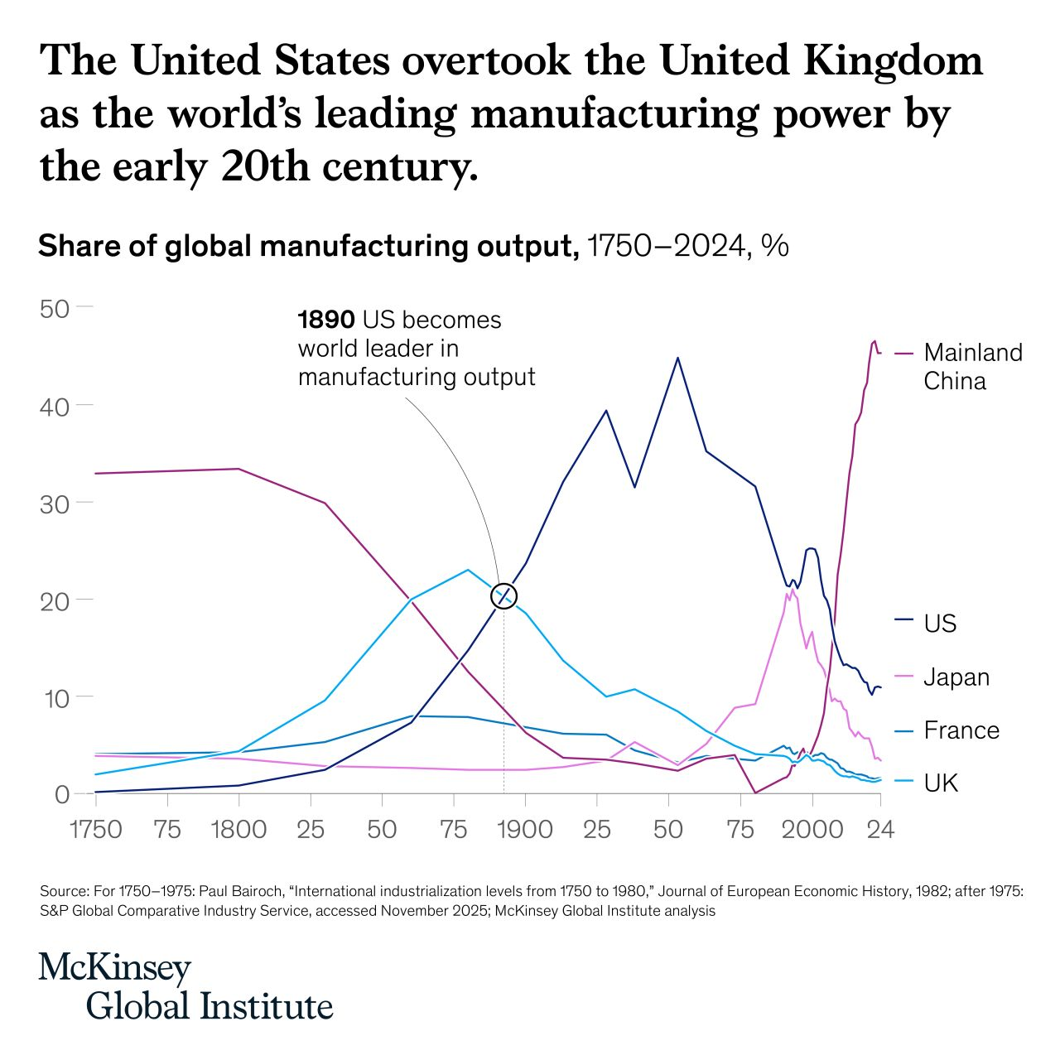

Slide 3
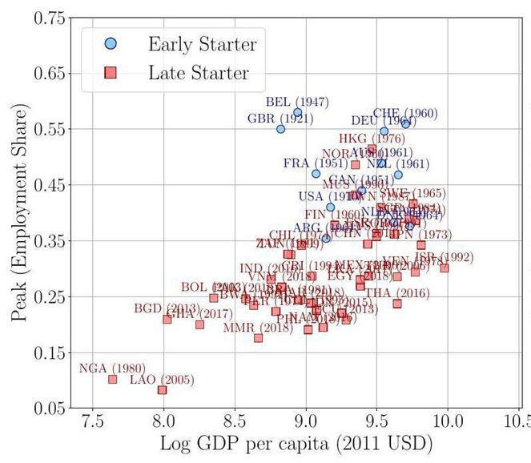
Notes:
https://voxdev.org/voxdevlit/industrial-development/structural-transformation-key-facts-and-canonical-theories

